Slide 1
Flocking Simulation
Implementation of natural flocking behavior of boids(bird-oid objects)
Yong-Chan Shin
CS 184 SP16

Slide 2
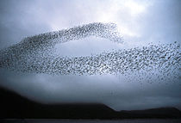
Flocking
This flocking algorithm consists of three simple steering behaviors which describe how an individual boid maneuvers based on the positions and velocities its nearby flockmates
The remarkable thing is that the algorithm controls the movement of boids not by directly changing velocity but by computing acceleration and use it to compute velocity.

Slide 3
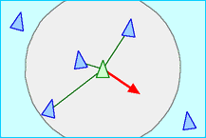
Separation
steer to avoid crowding local flockmates
Add all the difference vector between the position of the boid and that of the others and average it.

Slide 4
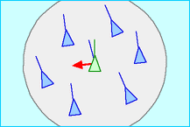
Alignment
steer towards the average heading of local flockmates
For every neighboring boid, average the velocity of neighbors which are in the fixed range. Then return the difference between the averaged velocity and the boid’s velocity.

Slide 5
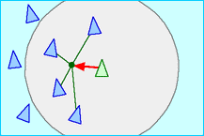
Cohesion
steer to move toward the average position of local flockmates
For every boid in the fixed range, average all the neighboring boids’ locations and compute the force that push the boid to the averaged position.

Slide 6
Demo

Slide 7
Technical summary
Mainly, I implemented the three types of forces: separation force, alignment force, and cohesion force. I had various problems, and one of the problems was to implement cohesion force. I implemented the two other forces with Craig Reynold’s paper, but I implemented the cohesion force by looking up several different sources explaining about it. After implementing the (relatively) long code for cohesion force, I implemented two options that if mouse is moving, the boids follow the goal and that if mouse is moving, the boids avoid the goal.
As I additionally implement two options, I found that there is common code with the two functions and part of the cohesion function, so I created a new function called “seek”.

Slide 8
Conclusion
Flocking algorithm gives highly life-like group behaviors of animals as swarm, so this can be widely used as motions of AI. Is was actually used 1992 Tim Burton film which simulated bat swarms and penguin flocks with computer graphics.
In the boids model (and related systems like the multi-agent steering behavior demos) interaction between simple behaviors of individuals produce complex yet organized group behavior. The component behaviors are inherently nonlinear, so mixing them gives the emergent group dynamics a chaotic aspect. At the same time, the negative feedback provided by the behavioral controllers tends to keep the group dynamics ordered. The result is life-like group behavior.
I tried to render cool images by loading .obj files, but I could not do that with this final project. I will personally keep working on this project to have better simulation.

